Slide 1
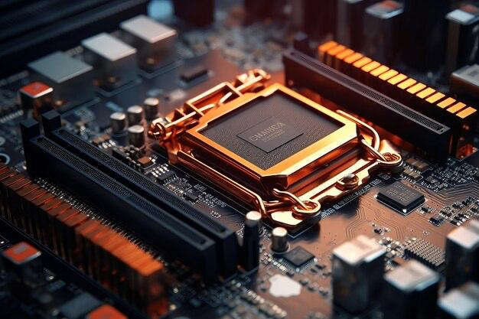
PID BALL BALANCING SYSTEM Embedded Systems Lab

Slide 2
Project Overview
Objective:
Implement a PID-controlled system to balance a ball on a track using Arduino, sensors, and servo motors.
Key Components:
Arduino microcontroller
Ultrasonic sensor (position feedback)
Servo motor (actuator)
Potentiometers (manual PID tuning)
Outcome:
Stabilize the ball at a set point with minimal error and oscillation.

Slide 3

Hardware Design

Slide 4
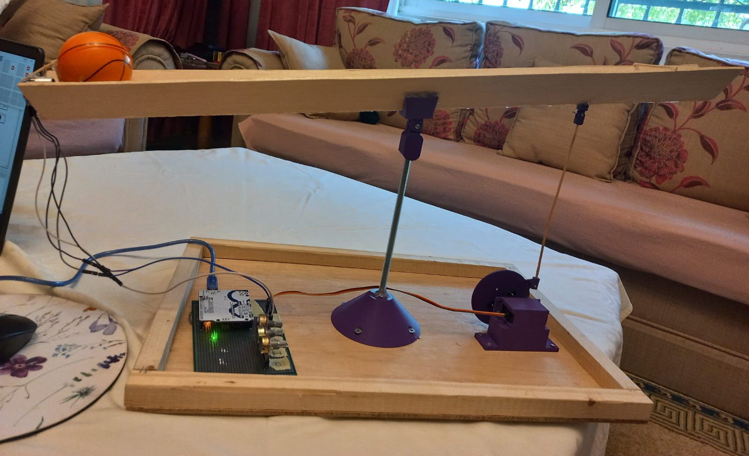

Slide 5
The system consists of
a track, a flexible holder, and a base. In addition to a servo motor, an ultrasonic sensor, and three potentiometers
The workflow
Sensor measures ball position → PID calculates error → Servo adjusts track angle.

Slide 6
Hardware Components
Arduino Board: Microcontroller platform.
Ultrasonic Sensor: Measures ball position at the track’s start.
Servo Motor: Moves the track up/down via a flexible joint.
Potentiometers: Adjust PID gains (Kp, Ki, Kd) manually.
3D-Printed Parts: Track, holder, and end-stop (prevents ball fall).

Slide 7

Software Design (Simulink)

Slide 8
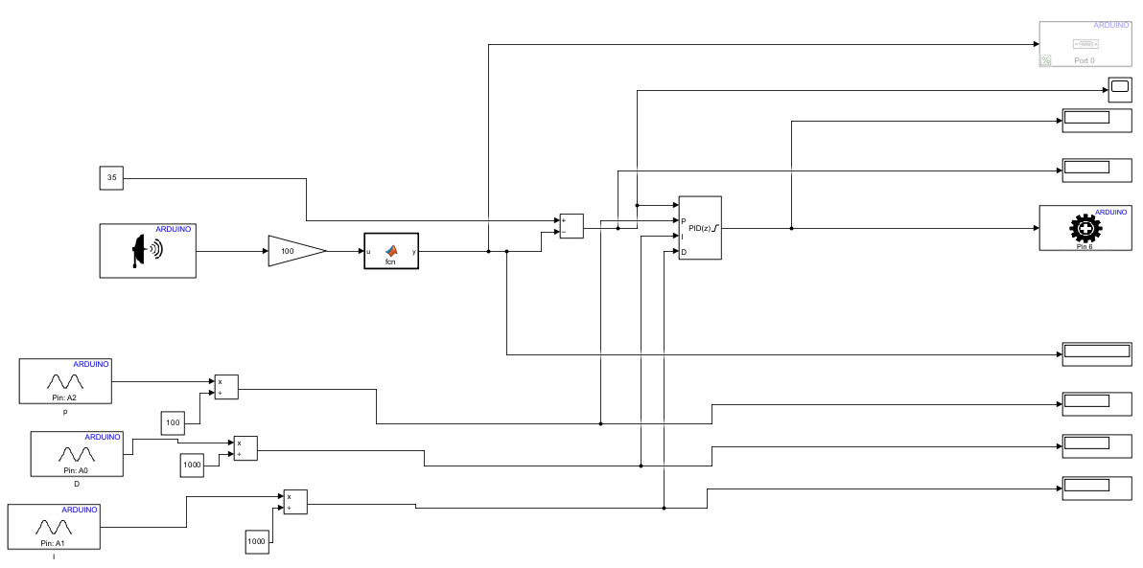

Slide 9
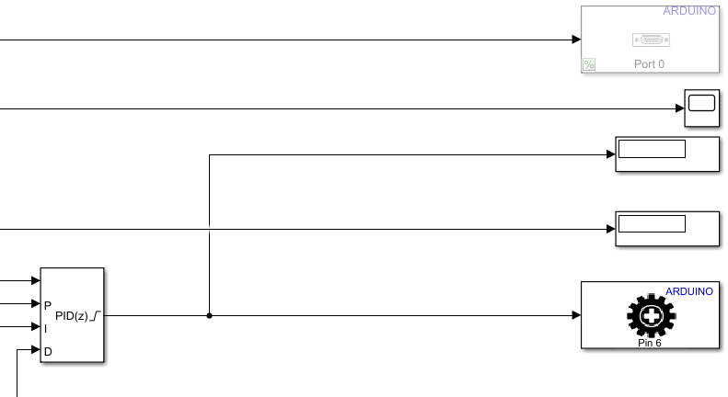
PID controller and servo

Slide 10
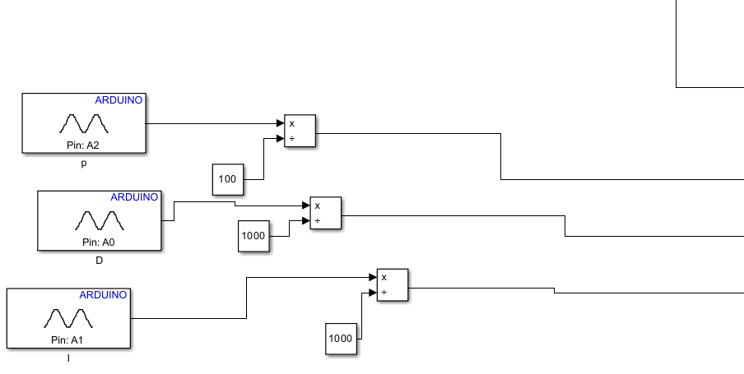
Potentiometers

Slide 11
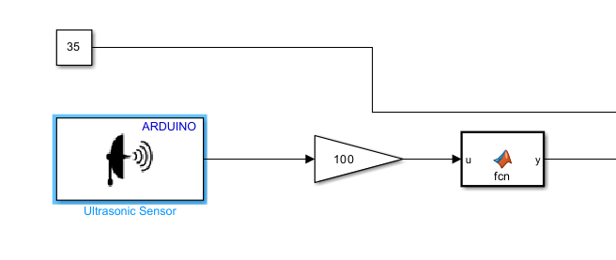
Ultrasonic

Slide 12
THANK YOU
By: Leen Bilto, Lujain Amro, Katrin Zagha

